Slide 1

Replacement Civic Centre
Council Meeting January 24, 2023

Slide 2

RCC Timeline
 |  |  |  |  |  |  |  |  |  |  |  |  |  |  |  |  |  |  |  | Nov 20 2019: Courtyard & Site Works |  |  |  |  |  |  | June - 100% DD On Hold WorkPlace strategy |  |  |  |  |  |  |  |  |  |  |  |  |  | Aug - 2021 Proceed with 43,500 ft² Provide class D Estimate |  |  |  |  |  |  |  | Mar 28 - 2022 42,600 ft² $41M
Jan 2018 |  |  |  |  |  |  |  |  |  |  |  |  |  |  |  |  |  |  |  |  |  |  |  |  |  |  |  |  |  |  |  |  |  |  |  |  |  |  |  |  |  |  |  |  |  |  |  |  |  |  |  |  |  |  |  |  |  |  | Jan 2023
 | 2018 |  |  |  |  |  |  |  |  |  |  |  | 2019 |  |  |  |  |  |  |  |  |  |  |  |  |  | 2020 COVID |  |  |  |  |  |  |  |  |  |  |  |  | 2021 |  |  |  |  |  |  |  |  |  |  |  |  |  | 2022
 |  | Mar 17-2018 New RCC |  |  |  |  |  |  | Jan 20 - 2019 : $27 M |  |  |  |  |  |  |  |  |  |  |  |  |  |  |  |  |  | 49,400 ft² $32M Class B |  |  |  |  |  |  |  |  |  | April 14 - 2021 Proceed with RCC Redesign |  |  |  |  |  |  |  |  |  |  |  |  |  |  | Summer 21,200 ft² $25.7M |  |  |  |  |  |  | Dec - 2022 Size - 44,600 ft² Class D - $50M
 |  |  |  |  |  |  |  |  |  |  |  |  |  |  |  |  |  | Aug 14-2018 RCC on Site

Slide 3
2016 – 2018
Options from the 2016 Pivotal Report
Option | Description
"Hold Steady" Scenario | “Hold Steady" Scenario Only immediate investment needs in the building to continue occupancy for a 3 to 5-year period which is the time needed to implement a long-term solution.
Option 2: | Options 2A and 2B both consist of complete retrofit of the current building to bring it as close as possible to modern office building standards. The building is expanded to provide additional capacity to meet staff growth needs.
2A | Building remains occupied. Addition to the building first creating on-site swing space. Other wings/floors will be sequentially emptied and renovated in three or four phases over time.
2B | Building will be totally vacated during construction. Staff will be temporarily accommodated in other space owned or leased by the Town.
Option 3: | A new stand-alone building on a Town-owned site, either the ROC site, or another suitable site.
Option 4: | A new stand-alone building on a third party owned site (e.g. Keswick Business Park).
Option 5: | A new building on the Multi-Use Recreational Complex (" M UR C") site in South Keswick, integrated with the proposed recreational facility.

Slide 4
2018 - 2020
 |  |  |  |  |  |  |  |  |  |  |  |  |  |  |  |  |  |  | Nov 20 - 2019 Courtyard - Site Plan Works
 |  |  |  |  |  |  |  |  |  |  |  |  |  |  |  |  |  |  |  |  |  |  |  |  |  | Mid 2020 June - 100% DD – On Hold WorkPlace strategy
Jan 2018
 | 2018 |  |  |  |  |  |  |  |  |  |  |  | 2019 |  |  |  |  |  |  |  |  |  |  |  |  |  |  | 2020 |  |  |  |  | COVID
 |  | Mar 17-2018 New RCC |  |  |  |  |  |  | Jan 20 – 2019: $27 M |  |  |  |  |  |  |  |  |  |  |  |  |  |  |  |  |  | 49,400 ft² $32M Class B
 |  |  |  |  |  |  |  |  |  |  |  |  |  |  |  | Aug 14-2019: RCC on Site

Slide 5
2021 to Jan 2023
 |  |  |  |  |  |  |  |  |  |  |  | Mar 28 - 2022 42,600 ft² - $41M Class D Design to $25M
 |  |  |  |  |  | Aug - 2021 43,500 ft² Provide class D (options at 36,500 ft²)
 |  |  |  |  |  |  |  |  |  |  |  |  |  |  |  |  |  |  |  |  |  |  |  | Jan 2023
 | COVID |  |  |  | 2021 |  |  |  |  |  |  |  |  |  |  |  |  | 2022
 |  | April 14 - 2021 Proceed with RCC Redesign |  |  |  |  |  |  |  |  |  |  |  |  |  | Summer 21,200 ft² - $25.7M |  |  |  |  |  | Dec - 2022 Bldg. size - 44,600 ft² Class D - $50M

Slide 6
44,600 ft² Concept Layout - Attributes
The various redesign were all carried out for good reason taking into account Cost, Customer Service, Workplace Strategy, Current/Flex/Future staff space, Department Functional Needs and Sustainability in terms of LEED design.
22 Bookable Offices
22 Flex workstations
10 – (4 to 6) person meetings rooms
Collaboration spaces throughout
Public space via Courtyard design
Building Expansion capabilities in the future

Slide 7
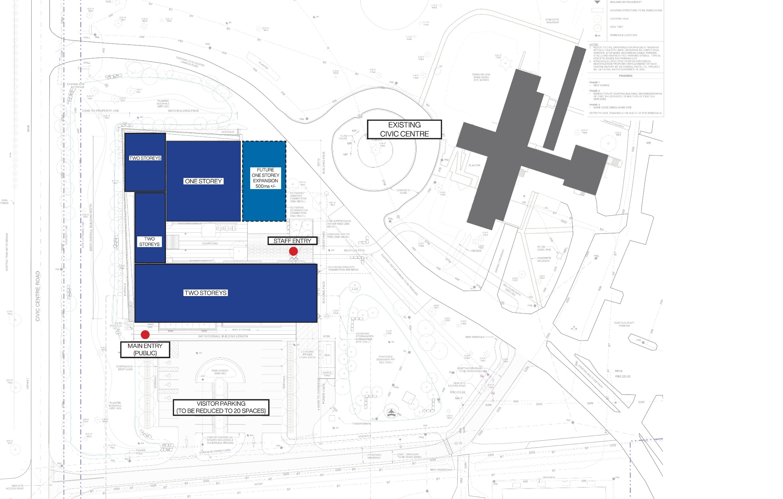
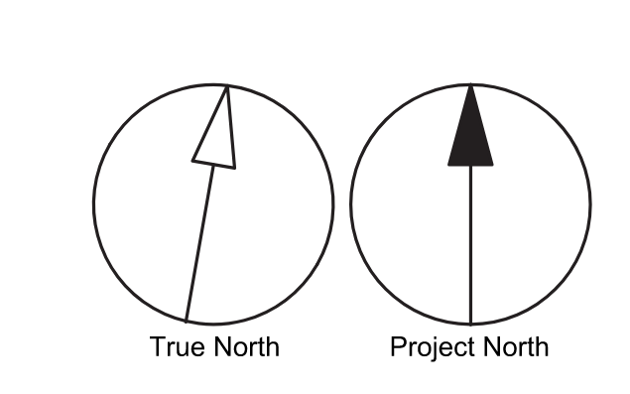
CIVIC CENTRE ROAD
2023 SITE PLAN DIAGRAM

Slide 8
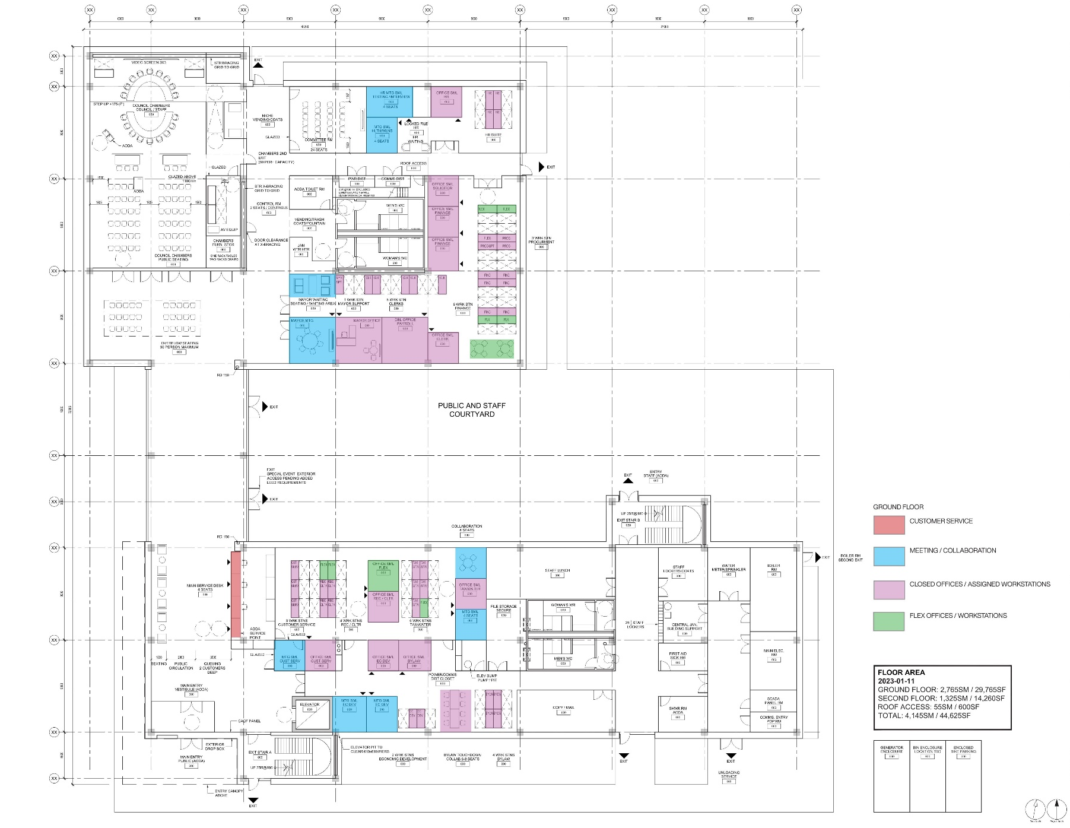
2023 BLOCKING / STACKING PLAN GROUND FLOOR OVERALL

Slide 9
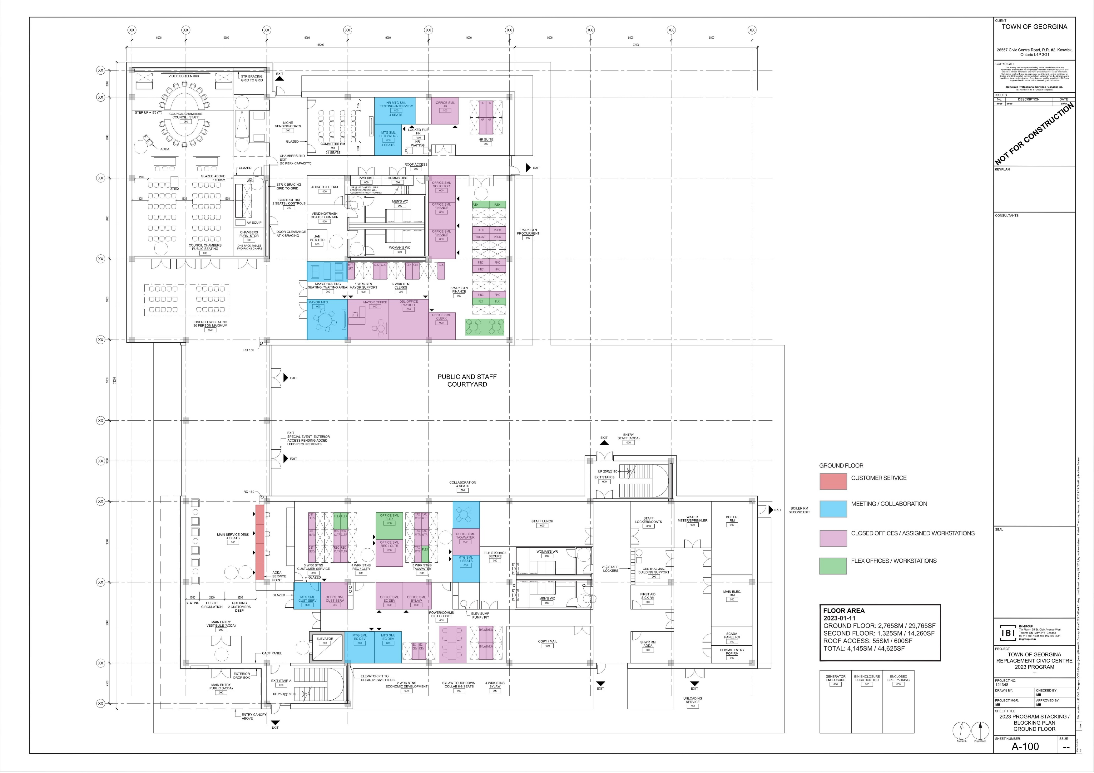
2023 BLOCKING / STACKING PLAN GROUND FLOOR SOUTH (PUBLIC ENTRY)

Slide 10
2023 BLOCKING / STACKING PLAN GROUND FLOOR NORTH

Slide 11
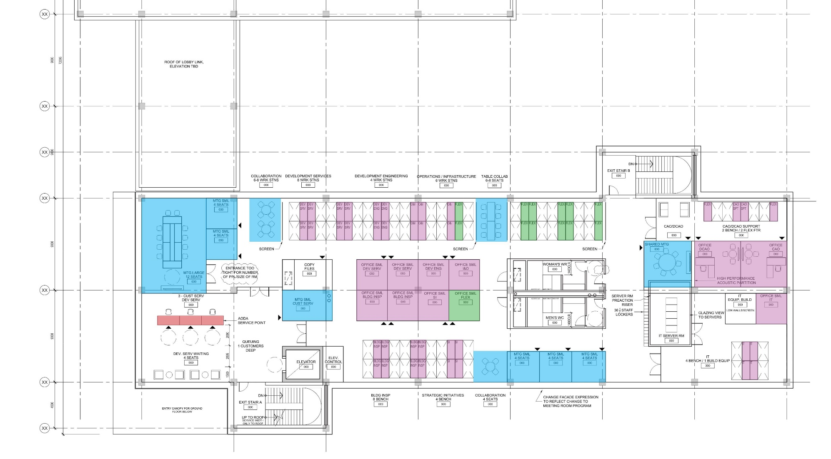
2023 BLOCKING / STACKING PLAN SECOND FLOOR (SOUTH WING ONLY)

Slide 12
Project Budget

Slide 13
Project Funding
A temporary capital line from Infrastructure Ontario will be used to assist in offsetting the larger negative reserve balances during the years 2025 to 2029

Slide 14
Recommendations
Approval of updated project budget of $50M
Approval for issuance of a Request for Tender (RFT)
Approval for the updated Consultant Budgets & Contingency
Approval for a LEED Gold certified Building
Approval of the Funding Strategy

Slide 15
AODA
Accessibility for Ontarians with Disabilities Act, 2005
S.o. 2005, chapter 11
Consolidation Period: From April 19, 2016 to the e-Laws currency date.
Purpose
Recognizing the history of discrimination against persons with disabilities in Ontario, the purpose of this Act is to benefit all Ontarians by,
(a) developing, implementing and enforcing accessibility standards in order to achieve accessibility for Ontarians with disabilities with respect to goods, services, facilities, accommodation, employment, buildings, structures and premises on or before January 1, 2025; and

Slide 16
AODA
AODA (Act) – stipulates compliance by Jan 1 2025
Civic Centre BCA report recommends compliance by 2025
BCA Report Engineer provided further clarification – referencing article that says:
  1) NO CHANGES have to be made by 2025 if the building you are in has no renovations or structural changes to do; the building is “grandfathered”.
  2) CHANGES HAVE TO BE MADE by 2025 if you build new or substantially renovate a space or building. All accessibility elements are then required to be to code under the Ontario Building Code (OBC).
  You are not forced to meet the AODA standard by 2025 if you are not doing anything to your building. It is only that the intent is to do so when a major renovation or new build is required.

Slide 17
AODA
The definition of extensive renovation in the Building Code is as follows: 11.3.3.2. Extensive Renovation
  (1) Where existing interior walls or ceilings or floor assemblies or roof assemblies are substantially removed in an existing building and new interior walls, ceilings, floor assemblies or roof assemblies are installed in the building, structural and fire-resistance elements shall be constructed in compliance with the requirements of the other Parts.
Current BCA document recommends various improvements/renovations over the next number of years
The Human Rights Code of Ontario plays another role in establishing our “duty to accommodate” persons with disabilities.

